Slide 1

Beyond the Classroom:
Centering Student Perspectives
Hosted by
Stephanie W. Cawthon, PhD Executive Director
Dalton Kendrik, MSEd
Graduate Research Assistant
Spring 2026 Townhall

Slide 2







Before We Start
1
2
3
4
5
Share in the chat:
We are recording this event
Your camera + microphone are turned off
ASL and CART captions provided;
Please be respectful
How do we remove barriers to disclosure for students with disabilities in higher education?
All recordings will be available on our YouTube in the event you can’t stay the entire hour.
More accessibility tips can be found on the event confirmation email or Event Access Page.
Chats are monitored. We will respond to all questions during our Q&A section of the event.
For your convenience we have disabled all but the necessary features for this event.

Slide 3


Welcome

Slide 4

Agenda
Welcome and What’s New at the Center
Deep Dive: Building Our Understanding of Disclosure
  What we know so far
  What our next study will focus on
Student Panel Discussion: Soren, MA, Jaxsen Day, MA, Ife Adekoya
Your Input on Disclosure Decision Factors
Conclusion + Feedback

Slide 5
What’s New

Slide 6


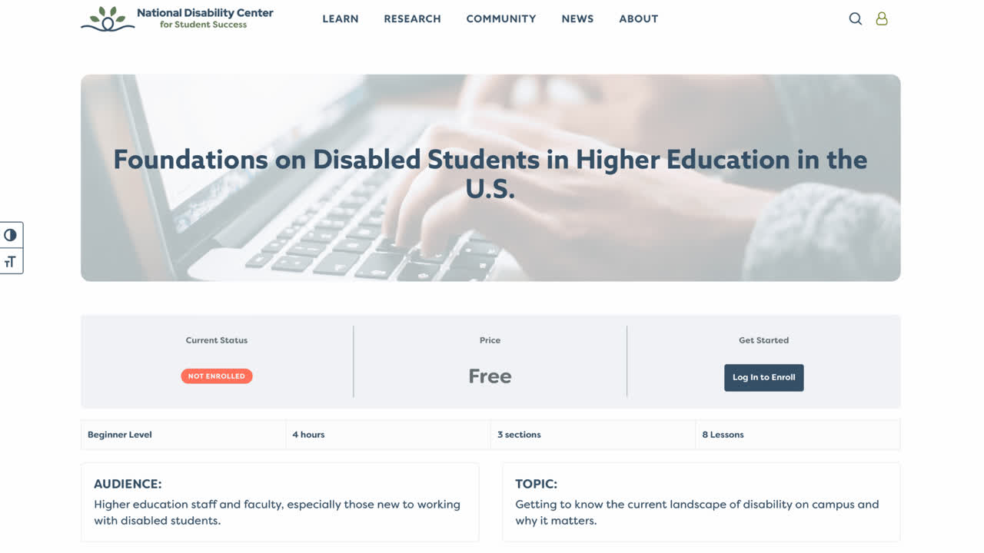
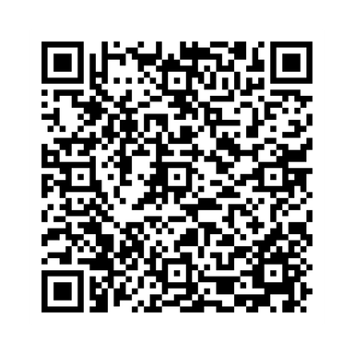
COURSE 1
Foundations on Disabled Students in U.S. Higher Education
Understand Disability
Apply Strategies
Learn key research on disabled students in U.S. higher education.
Turn research into practical approaches for accessible classrooms.
Explore Data
Examine national findings and Campus Accessibility Measure insights.
TAKE COURSE

Slide 7
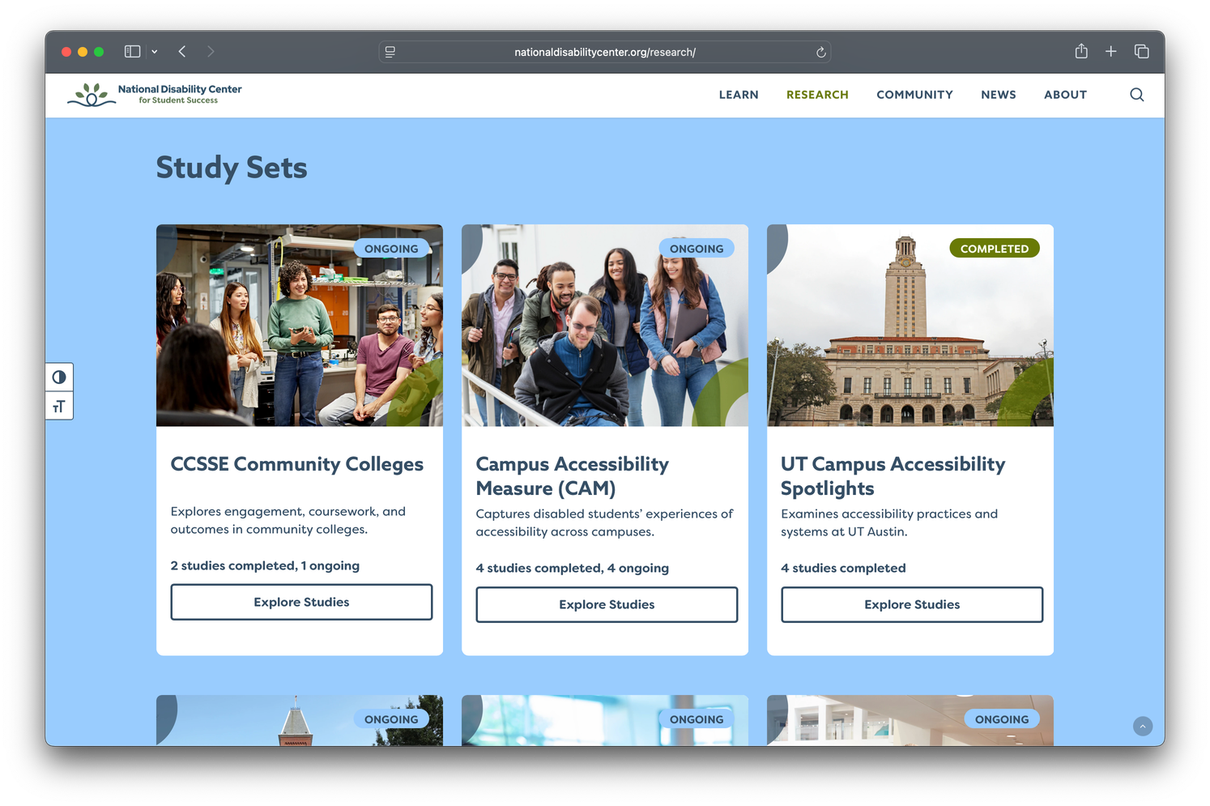
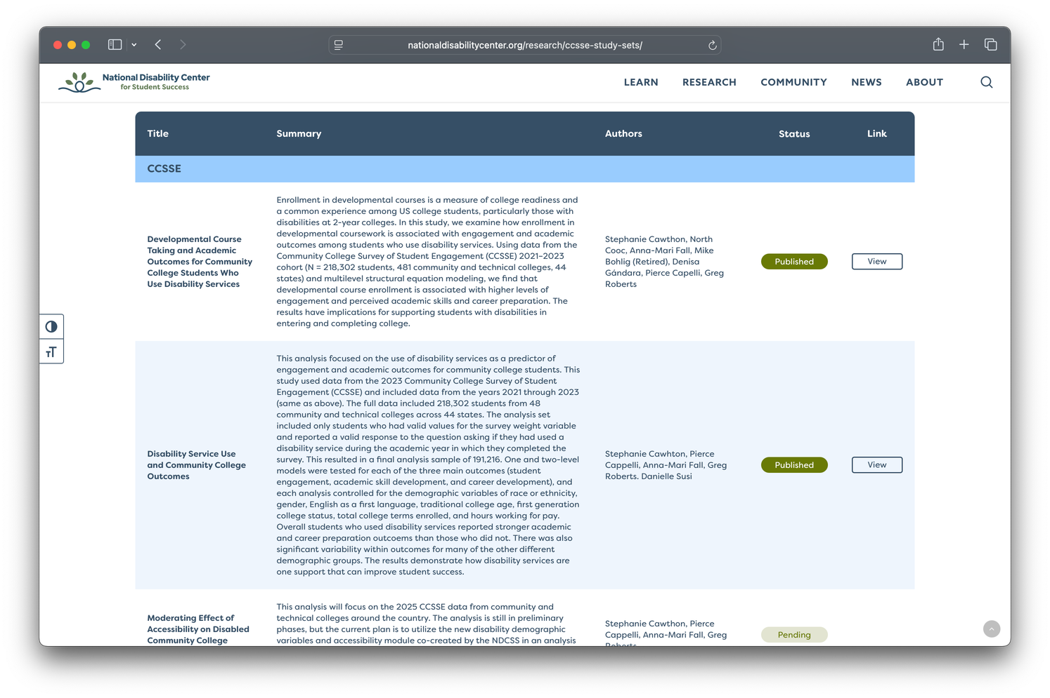
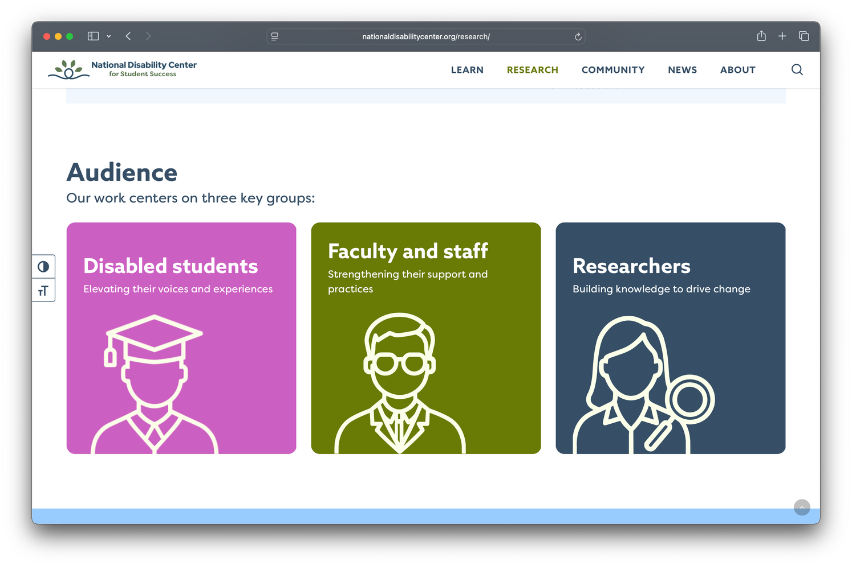
10 Study Sets to Support Disabled Student Success

Slide 8
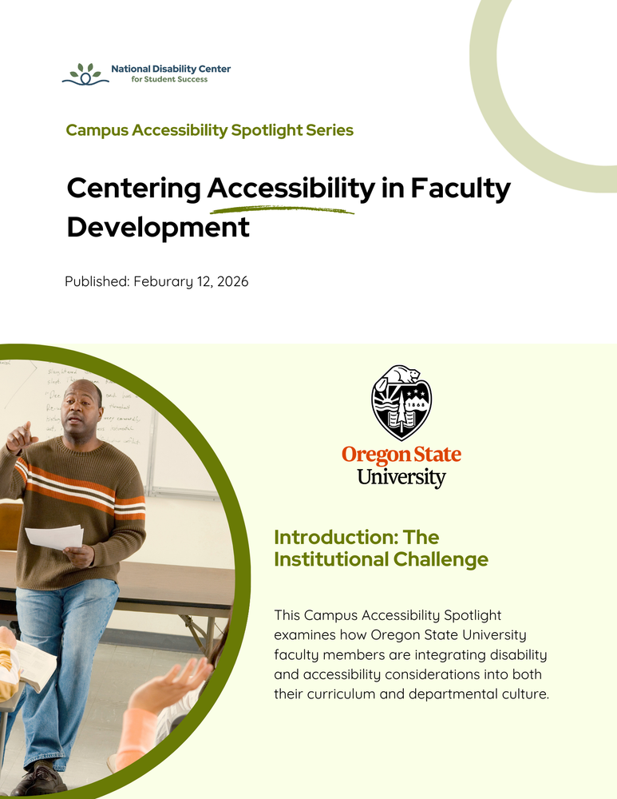
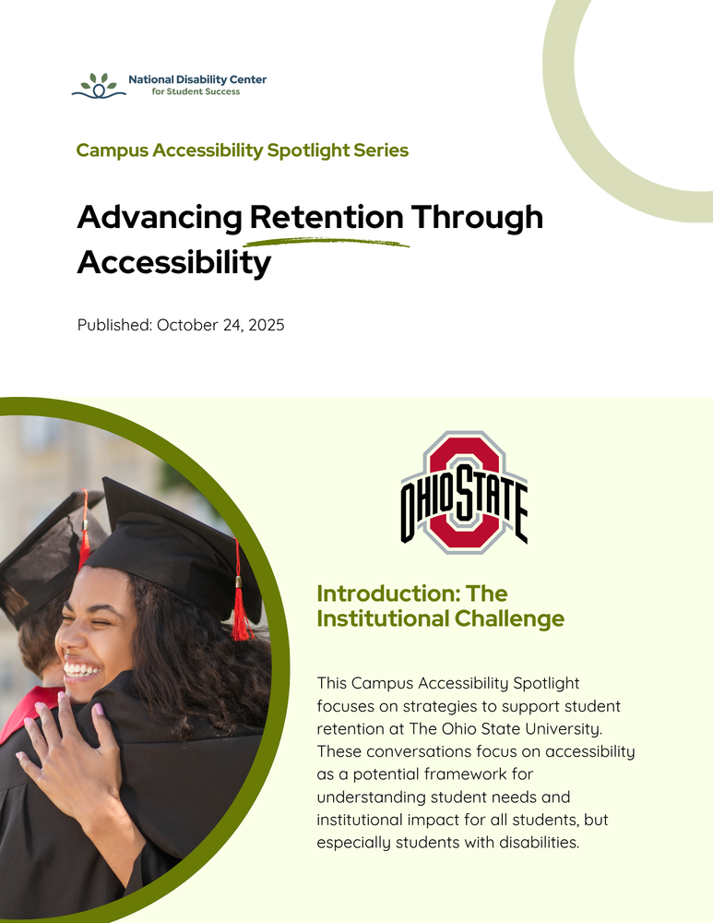
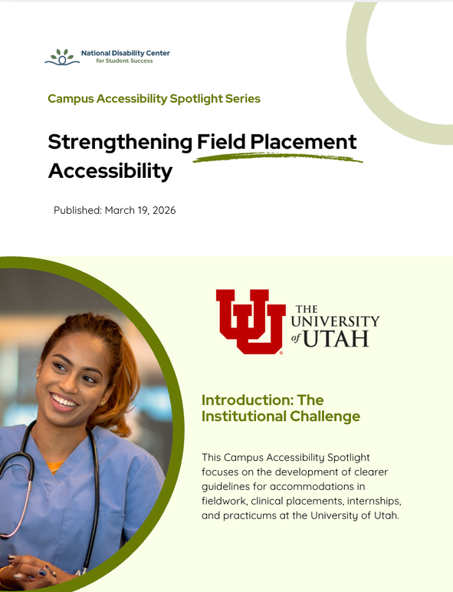
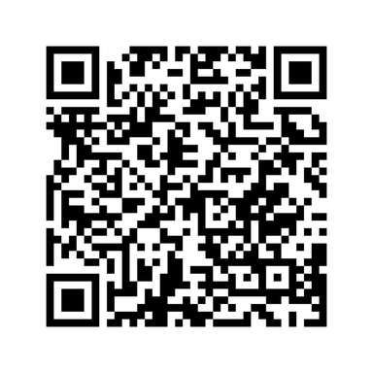
Campus Accessibility Spotlight Series
READ SPOTLIGHTS

Slide 9
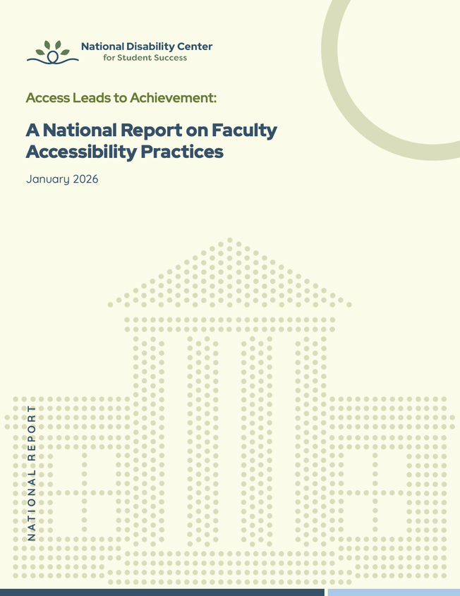
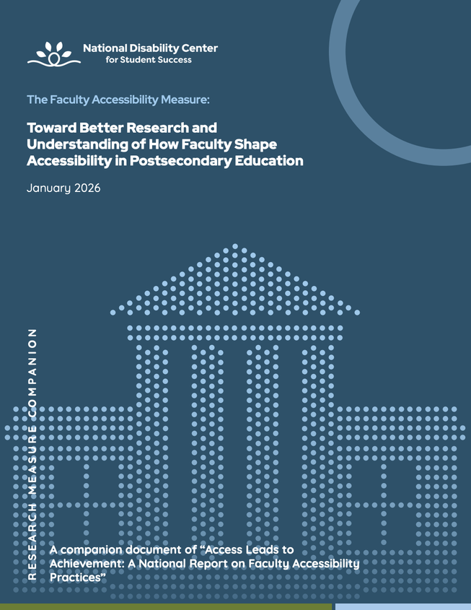
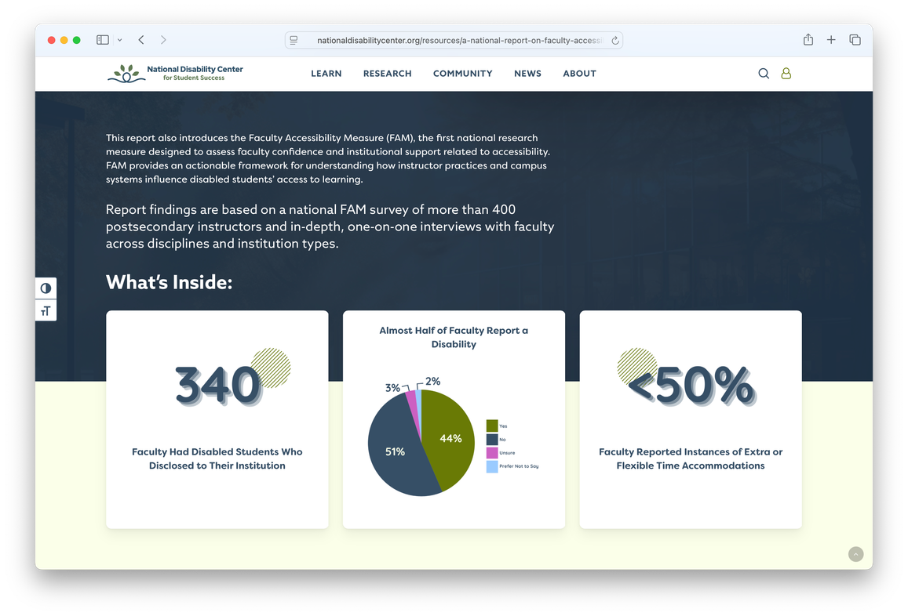
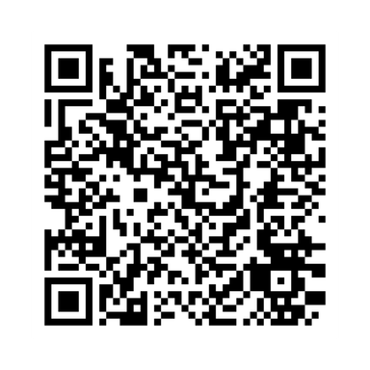
National Report on Faculty Accessibility Practices
  Top recommendations to improve accessibility on campus
  Survey results
  Faculty interviews
DOWNLOAD NOW

Slide 10
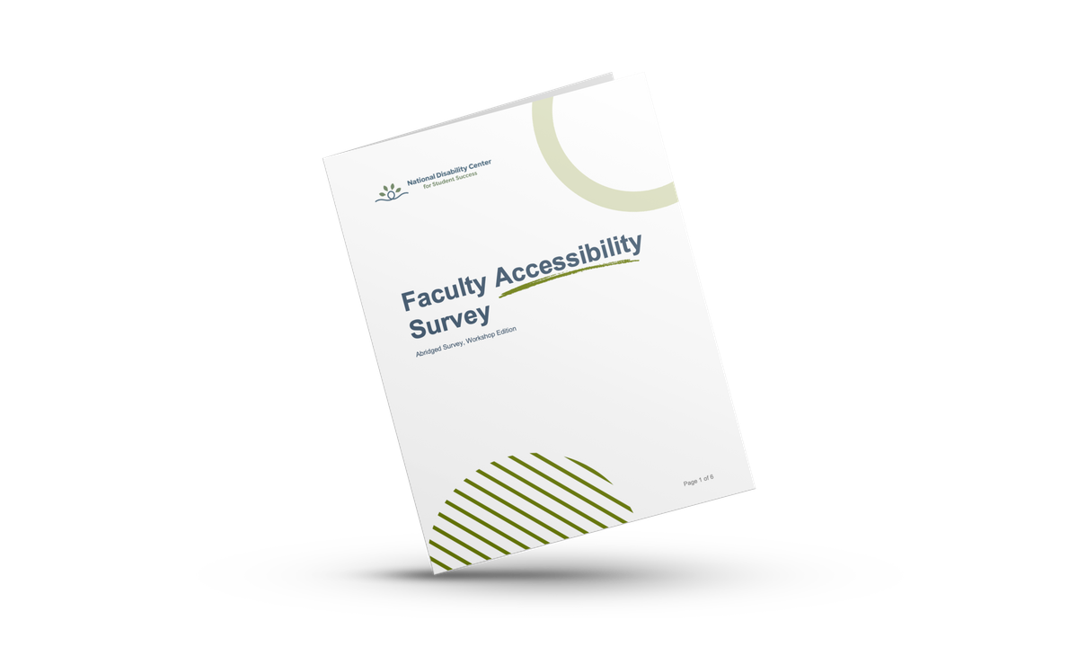
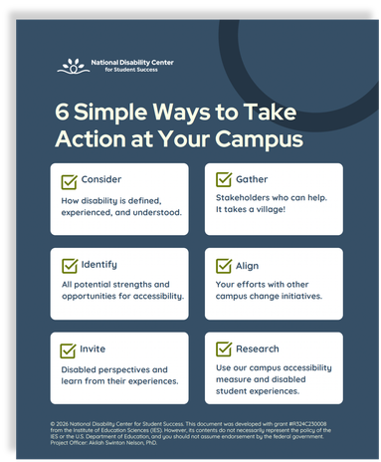
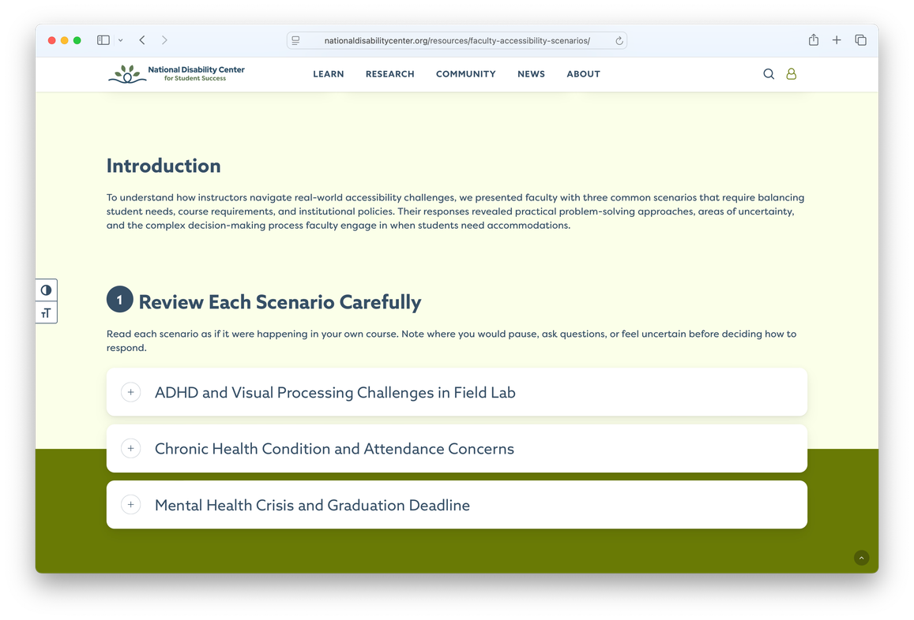
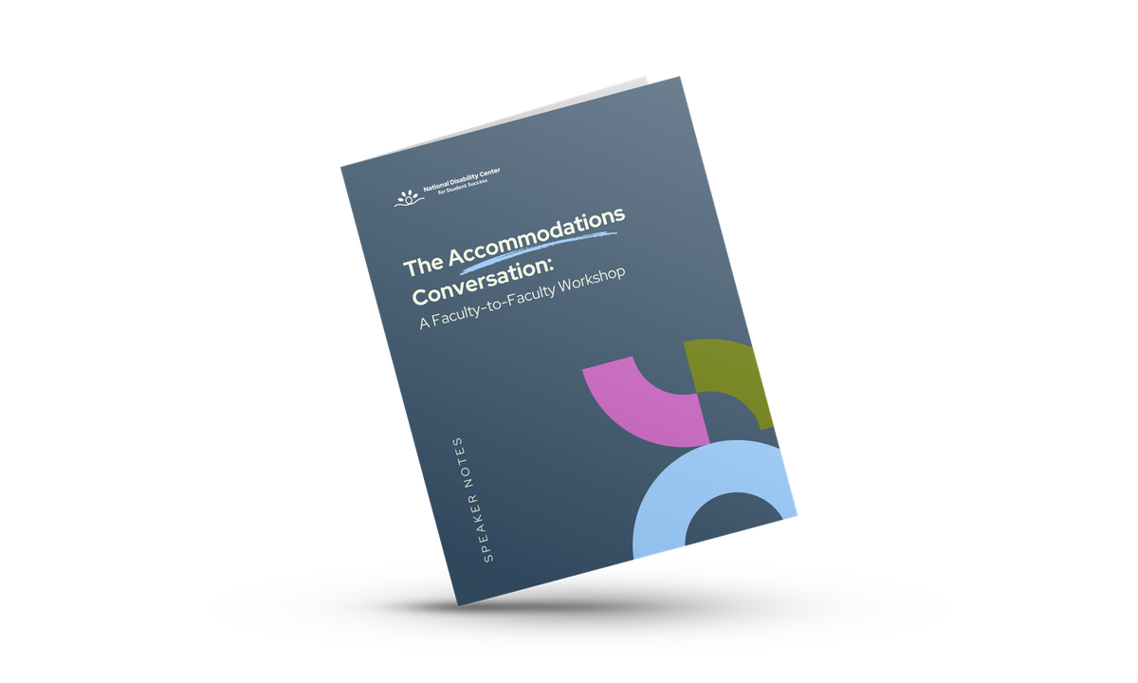
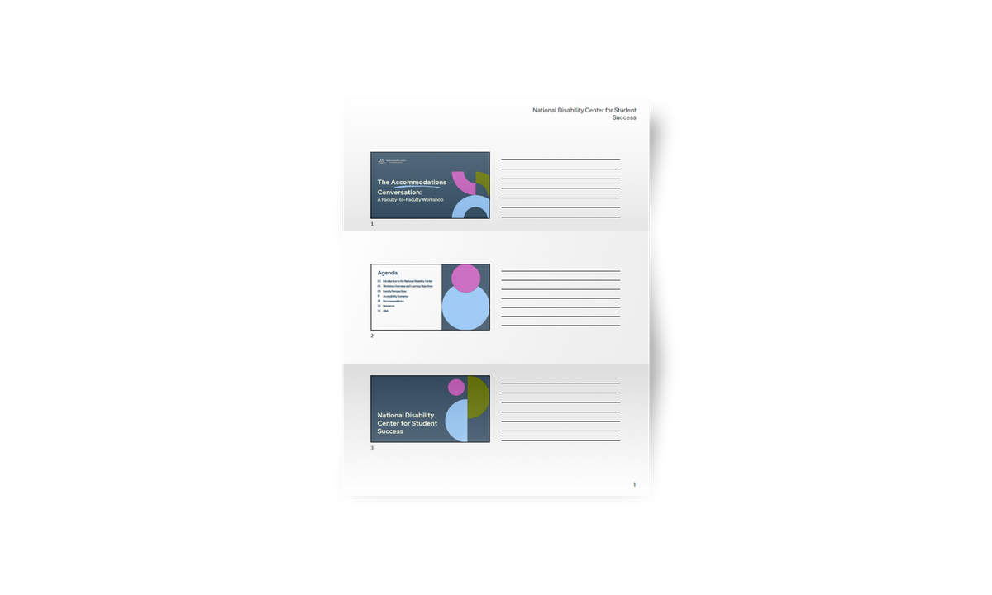


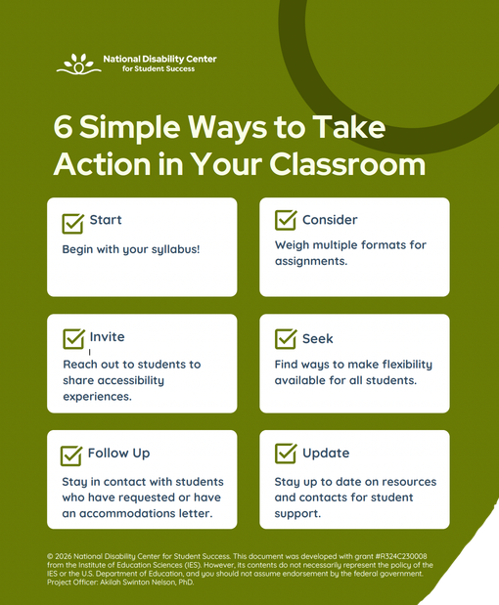

Even More Resources for Faculty!
The Accommodations Conversation:
A Faculty-to-Faculty Workshop
Faculty Scenarios: How Instructors Respond to Accessibility Challenges

Slide 11
Building our Understanding of Disclosure
Deep Dive

Slide 12
Our Next Study is on Disability Disclosure Decision Making
Moving to a new study set at the National Disability Center for Student Success: Disclosure Decision Making (including the decision not to disclose information).
Disclosure is central to how students obtain accommodations. Whether formally through the disability access office or informally through requests to instructors or TAs, sharing disability access needs is an integral part of many students’ higher education experiences.
But first, let’s think for a moment.
What is disclosure?
Disclosing disability information (e.g., diagnosis, disability type, length, etc.)
Disclosing disability identity (e.g., building relationships and sharing who we are)
Disclosing disability-related needs or barriers to achieving goals (e.g., accommodations or supports within education)

Slide 13
What we have learned about disclosure in our work so far…
1/2
36%
of students received a new disability diagnosis while in college
of students did not disclose their disability to anyone on campus
47%
of disabled students in higher education who disclosed, shared information with an accommodations office.

Slide 14
Important questions students ask themselves:
Their needs: How will disclosing help me?
Observed attitudes and behaviors of others: Will their ableism be directed at me?
Past disclosure experiences: Will I be stigmatized, doubted, or worse?
What did I gain last time? Was it worth it?
Relevance of the information: Is disclosing necessary? Why do they need this information?
Power dynamics: Will they use it against me? Will it affect my grade?
Apparentness of their disability: If they can’t notice it, why should I tell them?
It’s critical to note that disclosure research tends to focus mainly on accommodations office disclosure, but this is not always the main purpose for students. There are many benefits and costs that cut across friendships, classroom instruction, field placements, campus participation, and more.

Slide 15
Previous experiences with disclosure
Question #1
Inaccessible learning environments
Faculty preparation for disclosure
What are some topics or factors you think are most important to examine related to disclosure decision making?
Institutional responsiveness to requests
Authentic expression of identity
Student demographics that matter
Disclosure timing and purpose
Notes:
11

Slide 16
Panel Discussion

Slide 17
Q&A

Slide 18
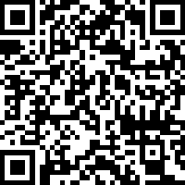
Share Your Feedback!
Evaluate this event below

Slide 19



Stay Connected
Subscribe to our LinkedIn Newsletter
Find us at
AERA 2026
Join our Communications Network
Apr 8 - 12

Slide 20
Thank you

