Slide 1

The Next Chapter in Accessibility: Connecting Faculty Practices with Student Realities
Hosted by
Stephanie W. Cawthon, PhD Executive Director
Fall 2025 Townhall

Slide 2







Before We Start
1
2
3
4
5
Share in the chat
We are recording this event
Your camera + microphone are turned off
ASL and CART captions provided
Please be respectful
Do you feel you and your institution are accessible?
All recordings will be available on our YouTube in the event you can’t stay the entire hour.
More accessibility tips can be found on the event confirmation email or Event Access Page.
Chats are monitored. We will respond to all questions during our Q&A section of the event.
For your convenience we have disabled all but the necessary features for this event.

Slide 3


Welcome

Slide 4

Agenda
Welcome and
Project Highlights From Year Two
What’s New on Our Website
The Current Status of Accessibility in American Higher Education
Panel Discussion : Maura Borrego, PhD
and Ryan Mata, PhD
Coming Soon
Conclusion + Feedback

Slide 5
Year Two

Slide 6



Building on Year Two
  Building on our year one foundation
  Our team expansion!
  The CAM Report + Measure release
  Student Interview project
  Community College Students (CCSSE) findings
  Collaborating with more partners:
    And more on the way!
    Updates on each of these are found on our Blog!

Slide 7

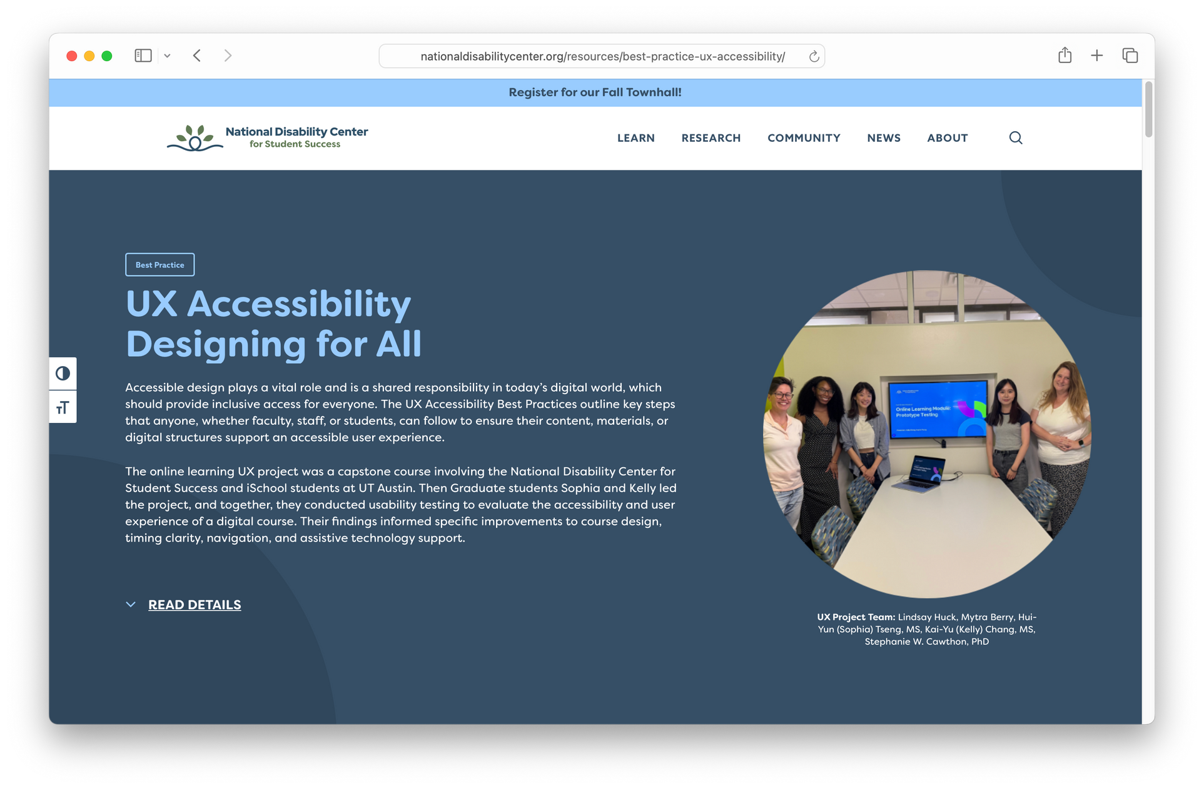
What’s New on Our Website
  Incorporating UX feedback
    Included latest resources to home page
    Simplified Learning Hub and Blog filters
    Developed UX best practice
    Added new resources to Learning Hub
  Never miss a newsletter
    Newsletter archive available
  Improved Townhall Page

Slide 8
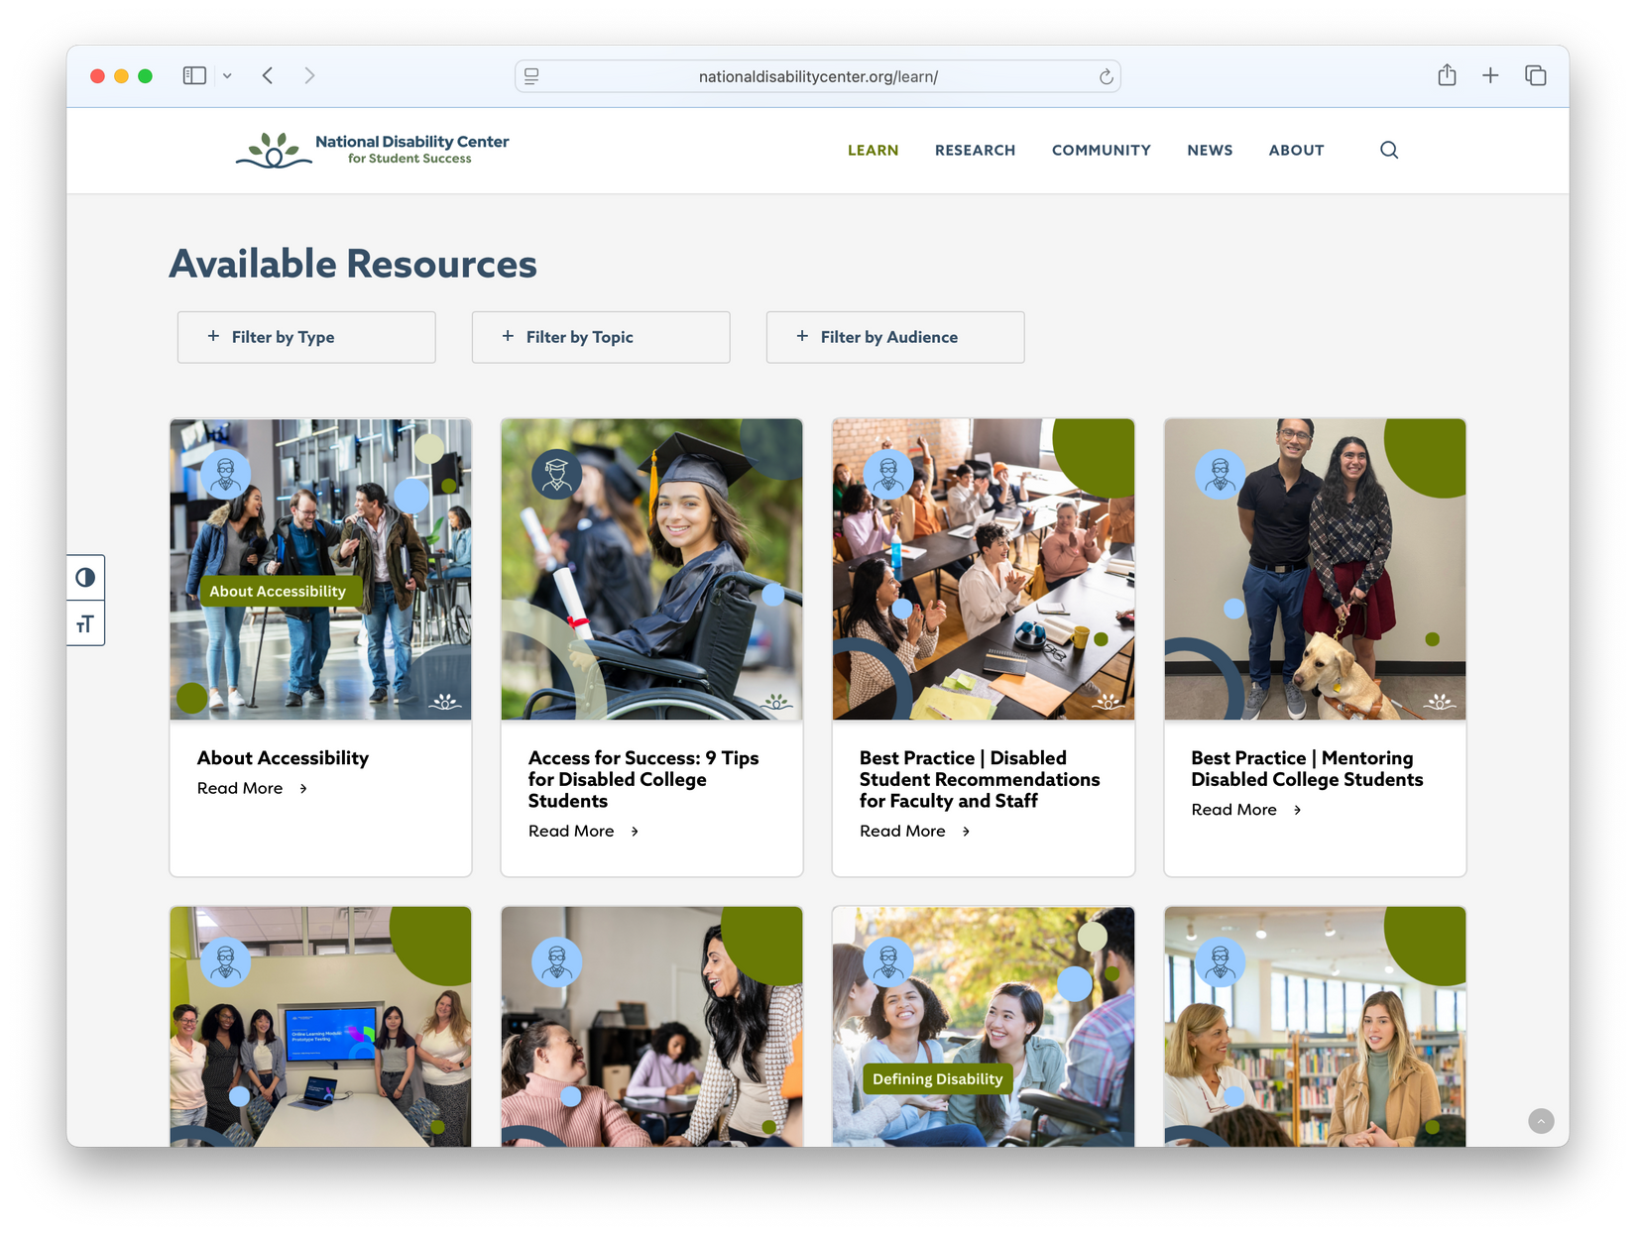
Best Practices
We have 8 new best practices, ready for you! Explore practical steps to support disabled students on the National Disability Center Learning Hub.

Slide 9
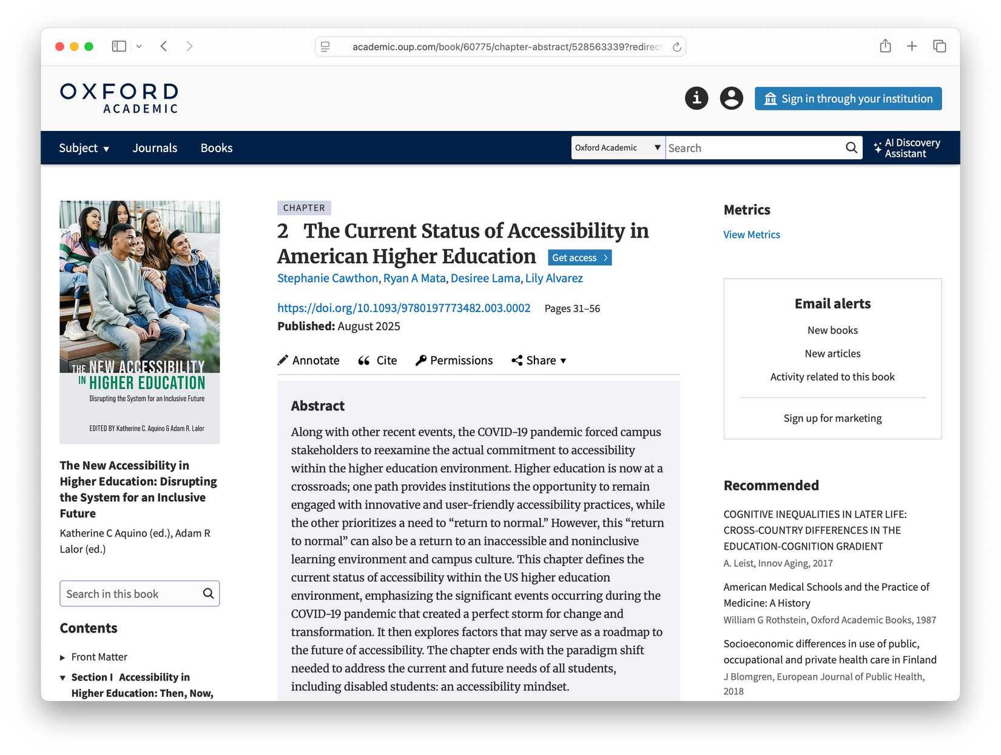
Oxford
University Press
Chapter 2: The Current Status of Accessibility in American Higher Education sets the groundwork for understanding accessibility before later chapters explore the crossroads ahead.
Featured in the volume New Accessibility in Higher Education: Disrupting the System.

Slide 10
Ensure all PDFs are accessible
Question #1
Provide all course material in advance
What is the most impactful strategy that INSTRUCTORS can use to increase accessibility for all students?
Offer late assignment options
Give choices for how to complete assignments
Allow revisions after feedback
Notes:
11

Slide 11
Train faculty on accessible teaching strategies
Question #2
Increase resources for accommodations
What is the most impactful initiative that INSTITUTIONS can use to increase accessibility for both faculty and students?
Shorten timeline to receive approved accommodations
Do an accessibility audit
Other? Put in the chat!
Notes:
11

Slide 12
Faculty Accessibility Measure
Preliminary Findings

Slide 13
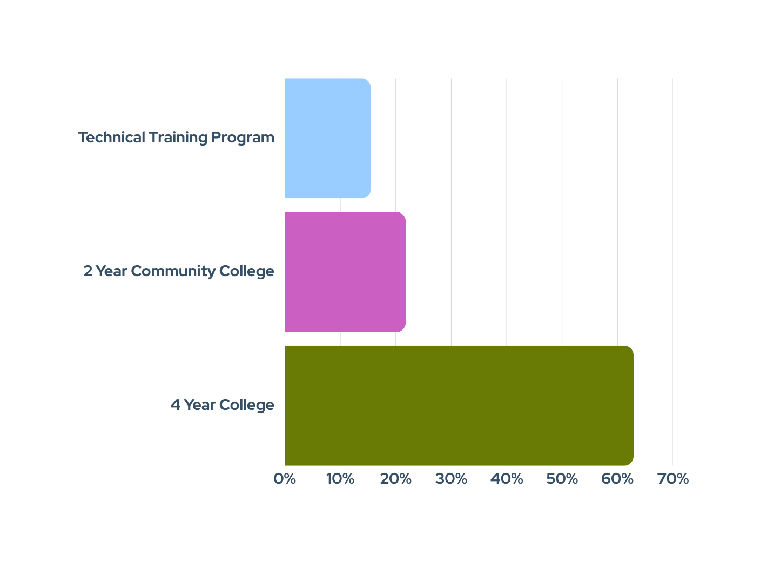
Institution Type
15.5%
21.8%
33.3%
62.9%

Slide 14
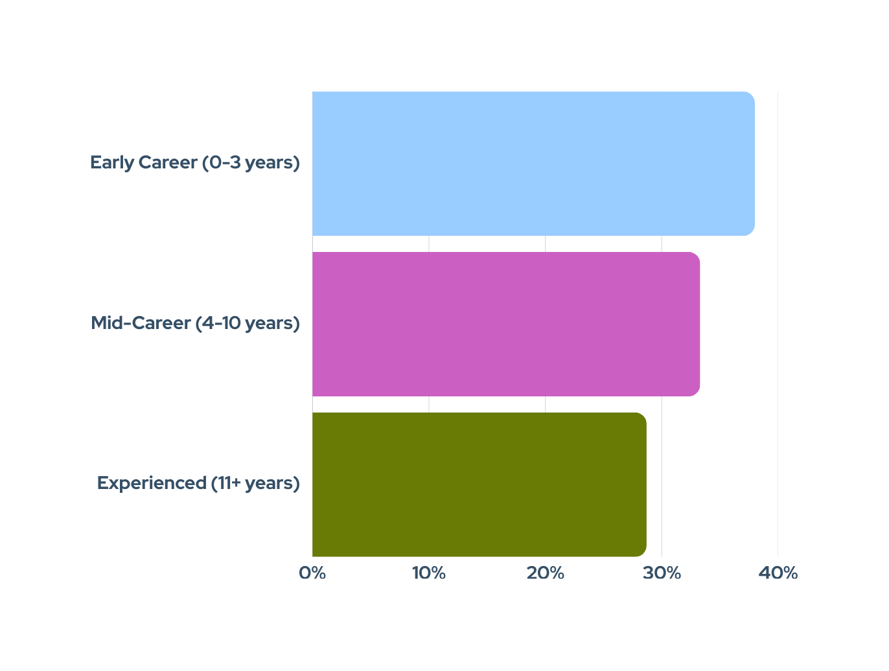
Teaching Experience
38.0%
M= 8 years (SD = 7.33)
33.3%
28.7%

Slide 15
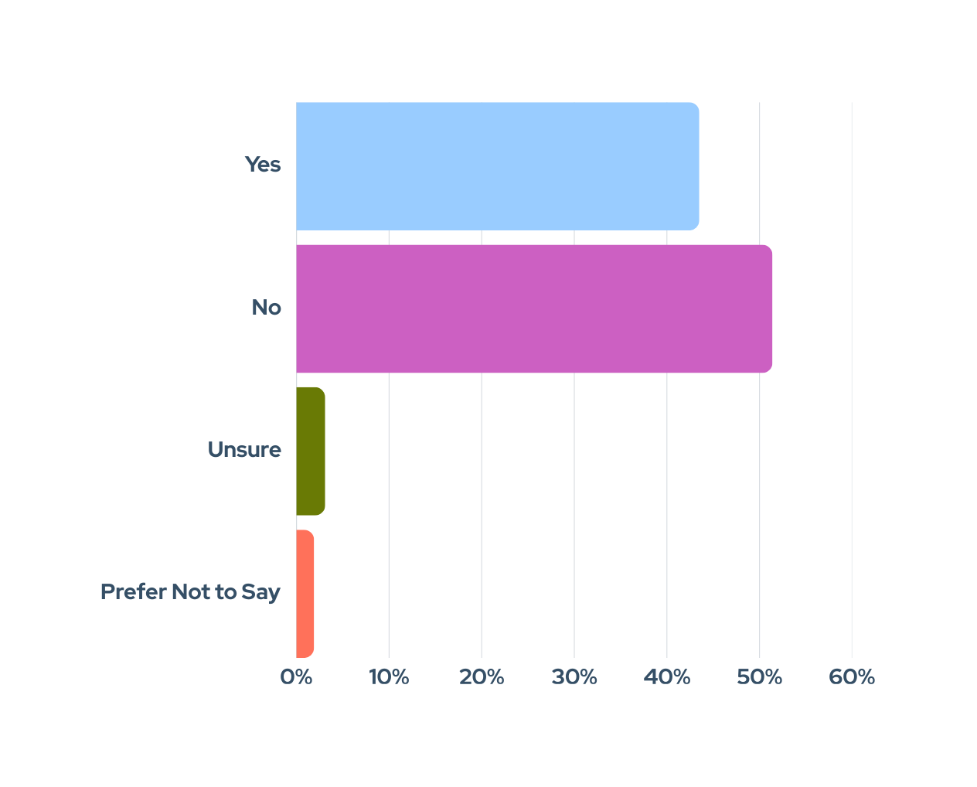
Disability Status
43.5%
51.4%
3.1%
1.9%

Slide 16
What Did This Study Measure?

Slide 17
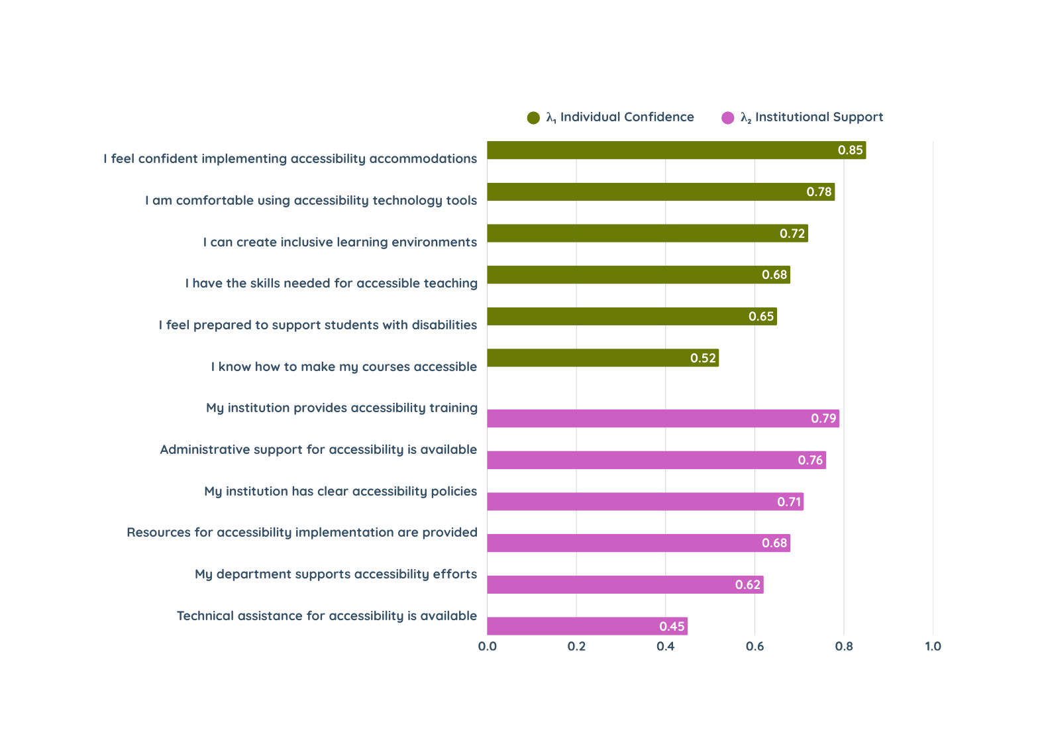
Exploratory Factor Analysis Results
Note: Factor loadings > .40 are shown.

Slide 18

Early Findings
  Faculty at technical training programs and 2-year colleges reported higher Individual Confidence scores than those at 4-year colleges.
  Faculty at 2-year institutions also reported significantly higher perceptions of Institutional Accessibility Support.
  Years of teaching experience did not significantly affect the relationship between institution type and Institutional Support. Perceived cost and personal accessibility to campus also showed no significant differences.
  Disabled faculty scored significantly higher on Individual Confidence than non-disabled faculty. While their Institutional Support scores were numerically higher, the difference was not statistically significant. No significant group differences were found in personal accessibility.

Slide 19
Bonus Interview Findings
Participants shared that the COVID-19 pandemic led to increased course accessibility due to the dramatic shift in teaching modalities.
This is because instructors:
  Redesigned their courses to adapt to online online, remote, or hybrid instruction, which revealed gaps in their teaching methods.
  Became increasingly aware of various accessibility aspects such as closed captions on videos, color contrast, the organization of their learning management systems, and verbally describing images/graphs.

Slide 20

And then when COVID hit, that was a big push for, How do we make things really accessible? How do we create videos with captioning and all that kind of stuff? So, because I was redesigning the whole course anyway to be in an online format, it was just me talking for 50 minutes in a lecture hall, which is hard for me to imagine now. But because I had to redesign it completely from the ground up, that's when I thought, OK, now is a good opportunity to just do this right.
- U.S. Higher Education Instructor

Slide 21
Panel Discussion

Slide 22
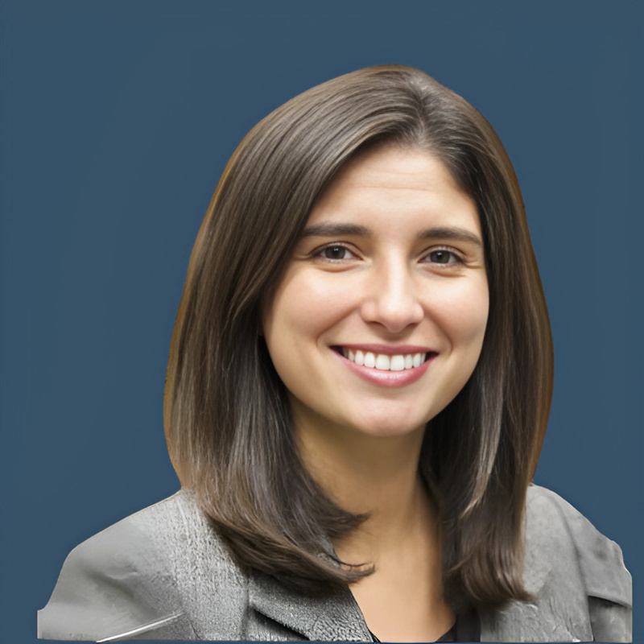
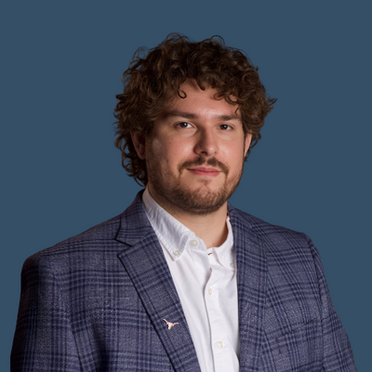
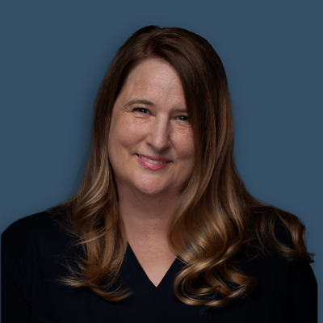
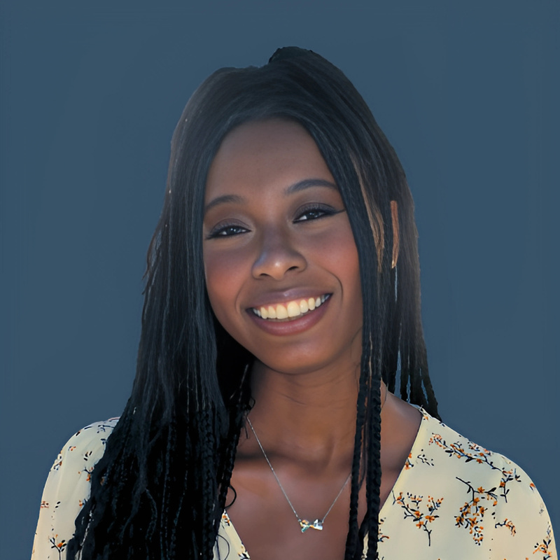
Familiar Faces at ASHE
https://www.ashe.ws/conference
“You always have to advocate for yourself”: Administrative Burdens and the Experiences of College Students with Disabilities
Date: November 13th, 9:45-11:00 AM MST
This session examines how administrative burdens, particularly those embedded in accommodation processes, shape academic success and well-being. Using an asset-based lens, it highlights how students navigate institutional barriers while drawing on their strengths and forms of cultural capital.
Denisa Gándara, PhD
Ryan A. Mata, PhD
Stephanie W. Cawthon
Ifeoluwa Adekoya

Slide 23


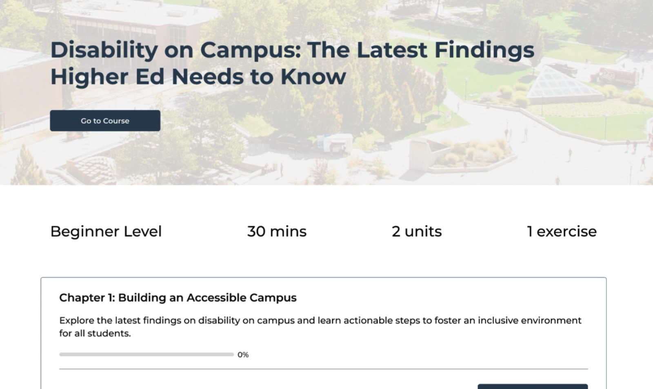
Introducing Online Training
Expected September 30th
Learn It
Apply It
Flexible modules shaped by real student and faculty experiences.
Turn insights into action with concrete steps to boost accessibility on campus.
Prove It
Show It
Each course includes quick quizzes to help you check your understanding.
Earn a certificate you can share proudly with colleagues and add to your portfolio.

Slide 24
Q&A

Slide 25
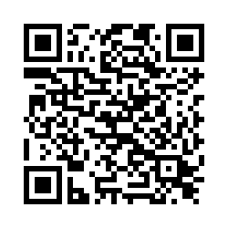
Share Your Feedback!
Collaborate in Our Embedded Evaluation

Slide 26



Stay Connected
Subscribe to our YouTube for recorded events
Find us at
ASHE 2025
Join our Communications Network
Nov 12 - 15

Slide 27
Thank you

Slide 28
BACK UP

