Slide 1
Spring 2025 Townhall
Townhalls Connect You Around the Nation
Hosted by
Stephanie W. Cawthon, PhD | Executive Director
February 20th, 2025

Slide 2
Share in the chat: What tools does your university use to create accessible digital content?
ASL and CART captions provided; more accessibility tips for Zoom
We are recording this event
Your camera/microphone are turned off
Please be respectful
Before
We Start

Slide 3
Welcome!

Slide 4
Agenda
Welcome Upcoming Events + Releases | Panel: Mario Guerra + Jeff Freels
Review of Campus Accessibility Spotlights | Your Input: Campus Accessibility Initiatives across the US
Deep Dive: Digital Content Accessibility | Conclusion

Slide 5
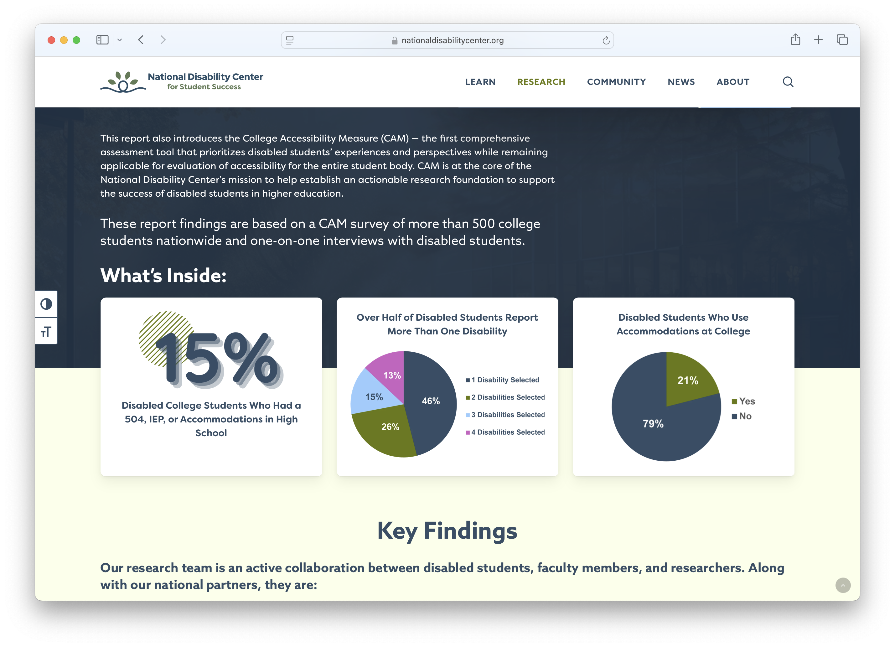
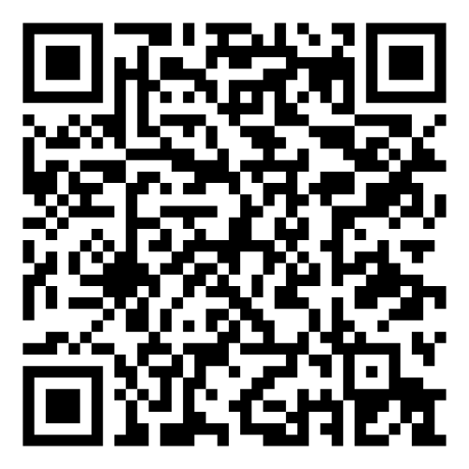
College Student National Report
Top recommendations to improve disabled students’ experience
Survey results
Student interviews
DOWNLOAD NOW
Notes:
Year One Highlights:
A true team effort
Student Fellows
Faculty Cadre
Dedicated Staff
Research Partners
Build our online presence: Website, Newsletter, and Social Media
Shout out to: Communications Network for their support and exchange
In year one we kept close to student centered approach
Campus Accessibility Measure
Student Interview Project
Community College Students (CCSSE)

Slide 6
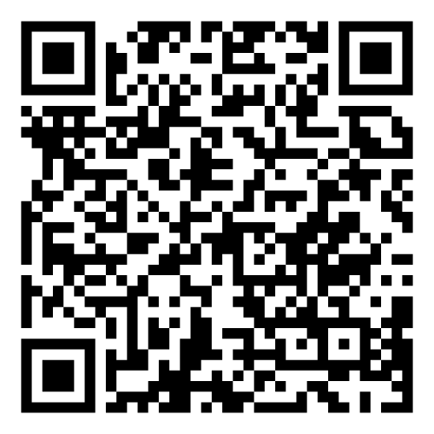
Campus Accessibility Spotlight Series
READ SPOTLIGHTS

Slide 7
Development of the Campus Accessibility Measure
Question #1
Understanding disabled students in community college
Which Year One activity is most valuable to you?
Insights from Research Reviews and Campus Spotlights
Online information from the website, newsletter, and social media
Details from the student interview project

Slide 8
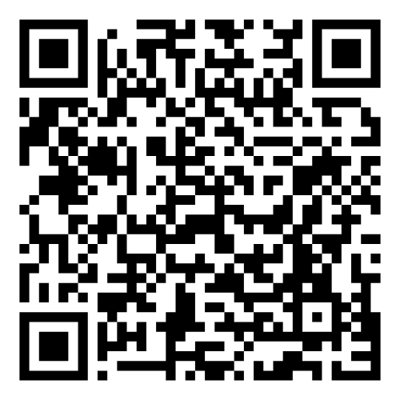
WEBCAST
Reach All Your Students:
Practical Tips for Teaching in Higher Ed
April 17 | 1:30 – 2:30 PM CST
Instructed by Andrew Dillon, PhD, Jen Moon, PhD, and Earl Huff, PhD
REGISTER TODAY!

Slide 9
Find us at AERA 2025
nationaldisabilitycenter.org/research/aera-2025/
Access for All? Including the Student Perspective in Measures of Campus Accessibility
Date: Wednesday April 23rd 2:30-4:00PM MST
Speakers: Desirée Lama, Ryan A. Mata, Soren Aldaco, Lily Grace Alvarez, Madeline O'Grady, Stephanie W. Cawthon
College Readiness and Academic Outcomes for Students who Use
Disability Services in Community Colleges
Date: Thursday April 24th 1:45-3:15PM MST
Speakers: North Cooc, Anna-Mari Fall, Greg J. Roberts, Denisa Gandara, Pierce Cappelli, Michael Bohlig, Stephanie W. Cawthon

Slide 10
Panel: Digital Content Accessibility

Slide 11
Q&A

Slide 12
Understanding accessibility guidelines
Question #2
What is the biggest challenge when creating accessible digital content?
Using tools or software to make content accessible
Testing content for accessibility
Balancing accessibility with time constraints

Slide 13
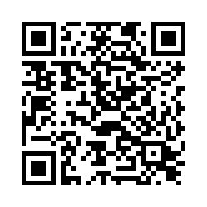
Share Your Feedback!
Collaborate in Our Embedded Evaluation

Slide 14
Stay Connected
Attend our Webcast
Find us at
AERA 2025
Join our Communications Network
April 17
April 23 - 27

Slide 15
Thank You!

Slide 16
BACK UP

Slide 17
In Case You Missed It
Check out our newly released research and content.
Campus Spotlights
Students + Accessibility Report
Campus Accessibility Measure
Fall Webcast Video

Slide 18
PDFs
Question #3
If we deep dive more into this topic, which type of file should we focus on first?
PowerPoint presentations
Videos with captions
Website or online content

Slide 19
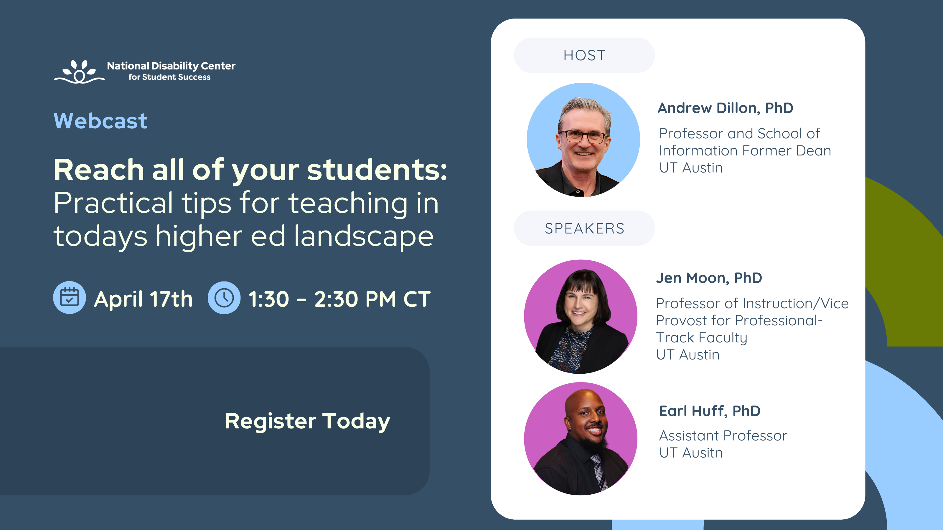
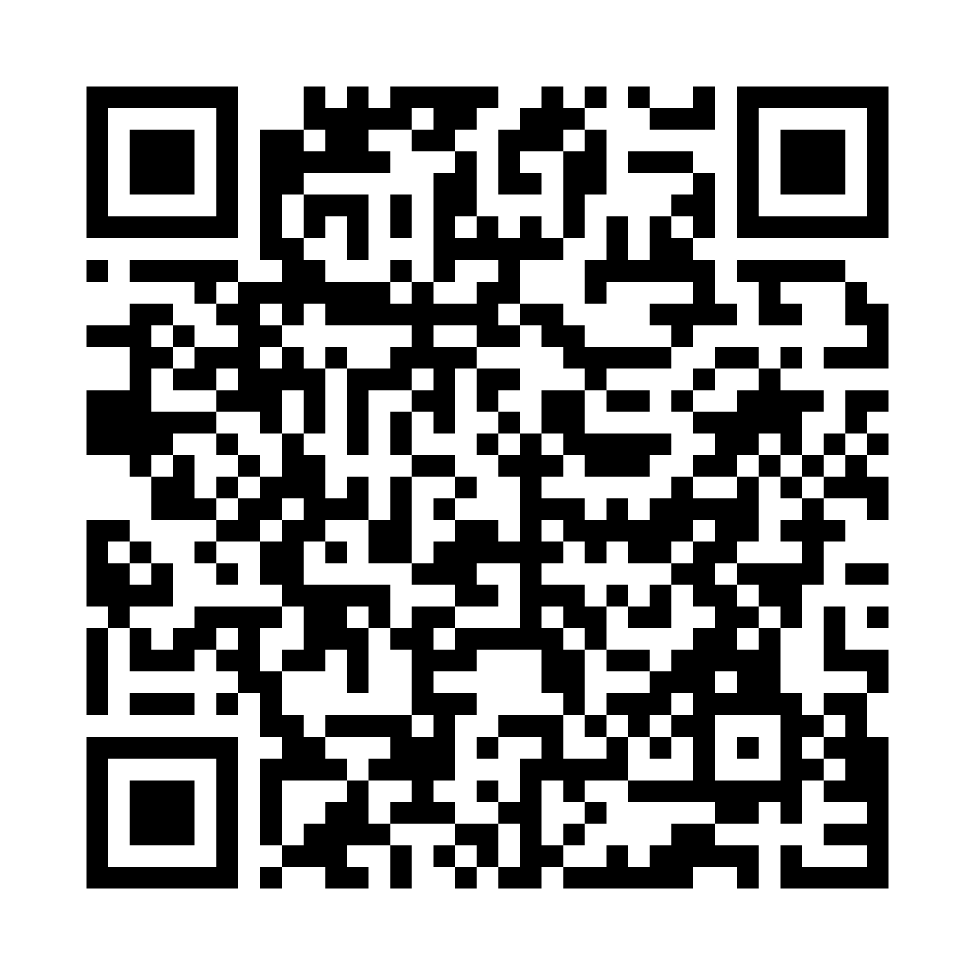
Add new QR

Slide 20
Lack of awareness
Question #2
What is the biggest barrier to digital content accessibility on your campus?
Insufficient training or resources
Limited funding for accessibility tools
Resistance to change or prioritization

Slide 21
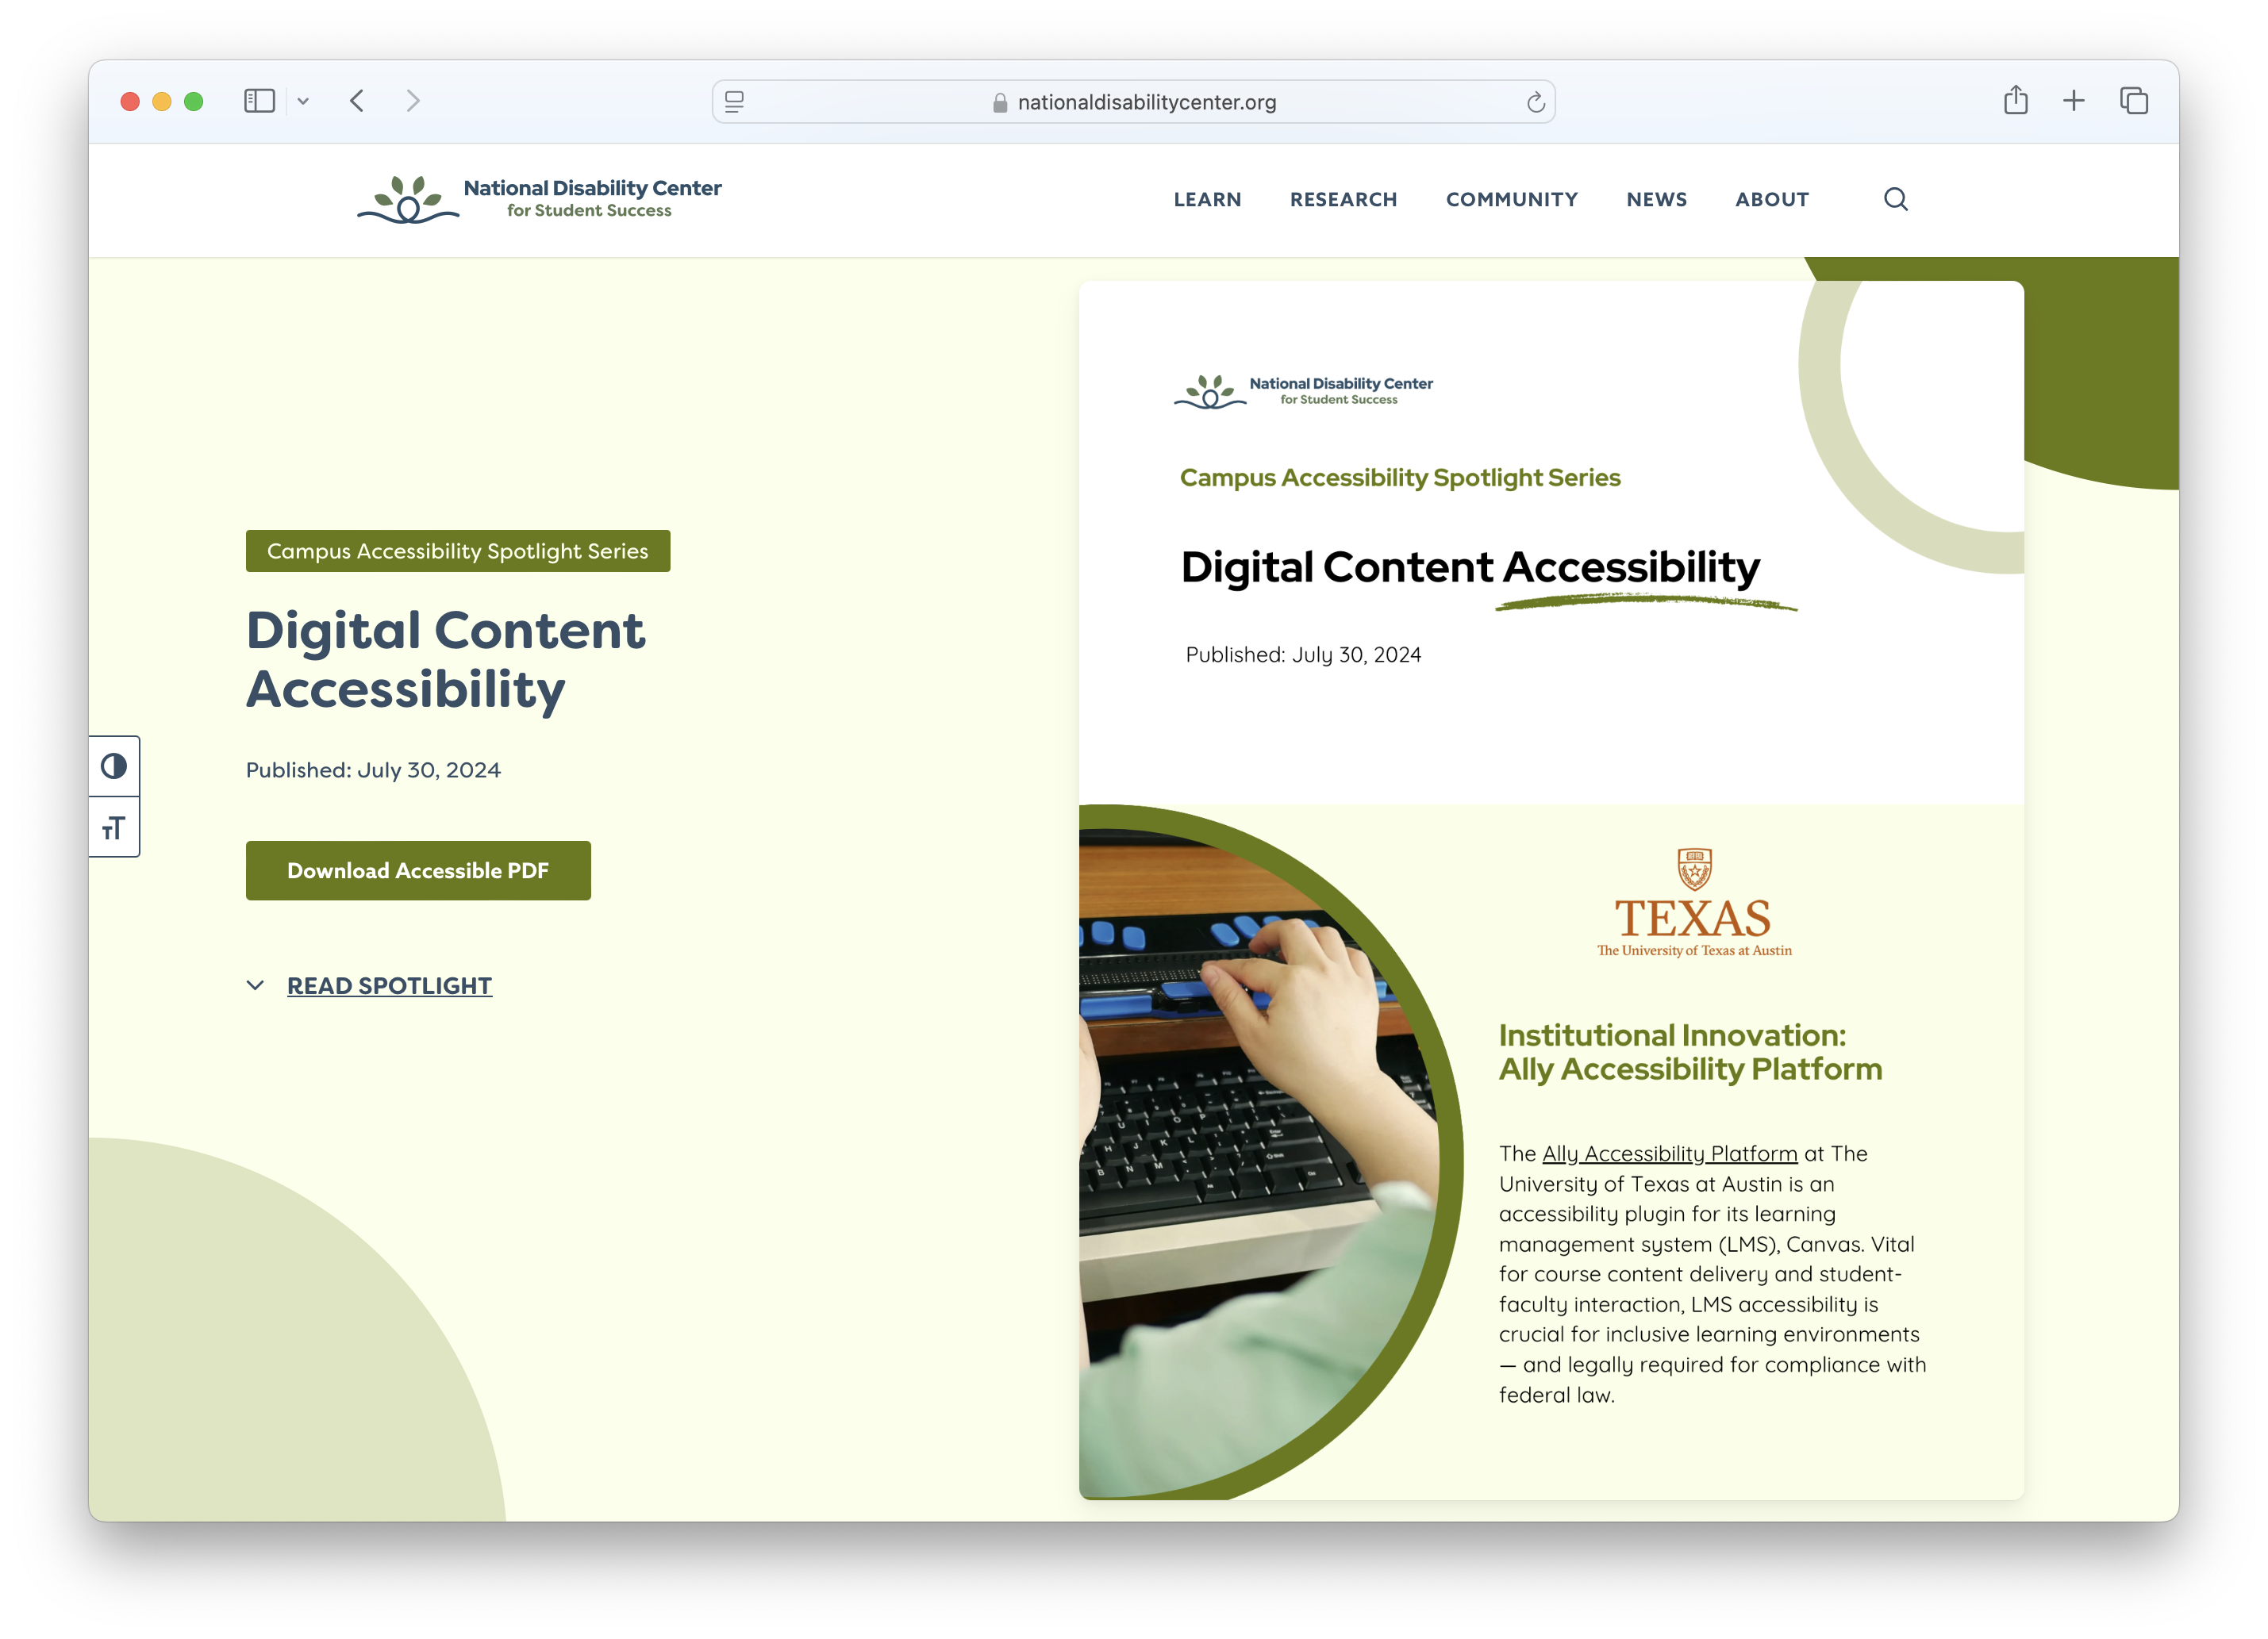
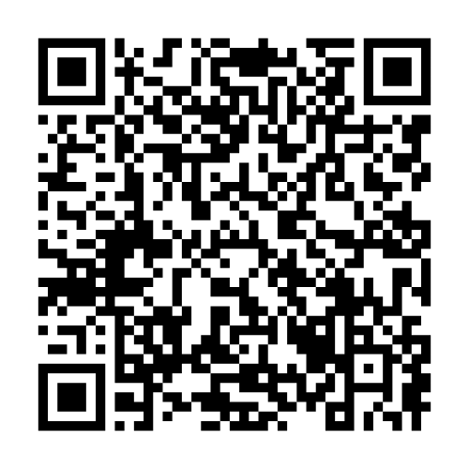
Campus Spotlight
Digital Content Accessibility
Contributors:
Jeff Freels, PhD
Mario Guerra

